Slide 1
CONTINUATION OF WATER REQUIREMENTS AND AVAILABILITY RECONCILIATION STRATEGY FOR THE MBOMBELA MUNICIPAL AREA (Crocodile Sabie River System Reconciliation Strategy) Strategy Steering Committee Meeting StraSC 3 18 September 2019

Slide 2
CONTINUATION OF WATER REQUIREMENTS AND AVAILABILITY RECONCILIATION STRATEGY FOR THE MBOMBELA MUNICIPAL AREA (Crocodile Sabie River System Reconciliation Strategy) Strategy Steering Committee Meeting StraSC 3 Item 2: Attendance and Apologies

Slide 3
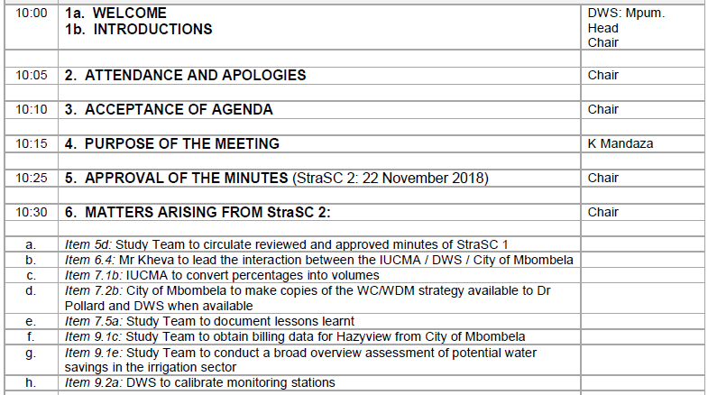
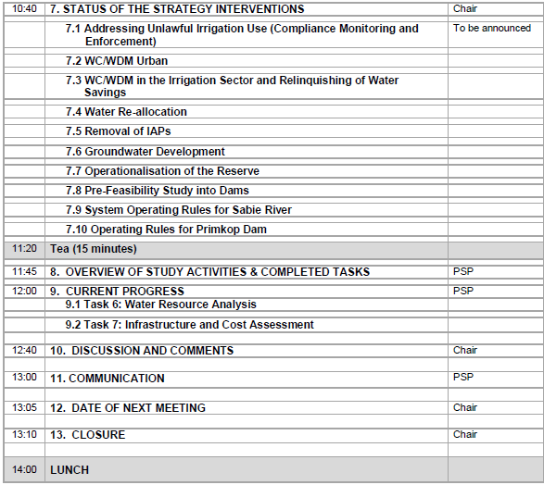
Agenda

Slide 4
CONTINUATION OF WATER REQUIREMENTS AND AVAILABILITY RECONCILIATION STRATEGY FOR THE MBOMBELA MUNICIPAL AREA (Crocodile Sabie River System Reconciliation Strategy) Strategy Steering Committee Meeting StraSC 3 Item 4: Purpose of the Meeting

Slide 5
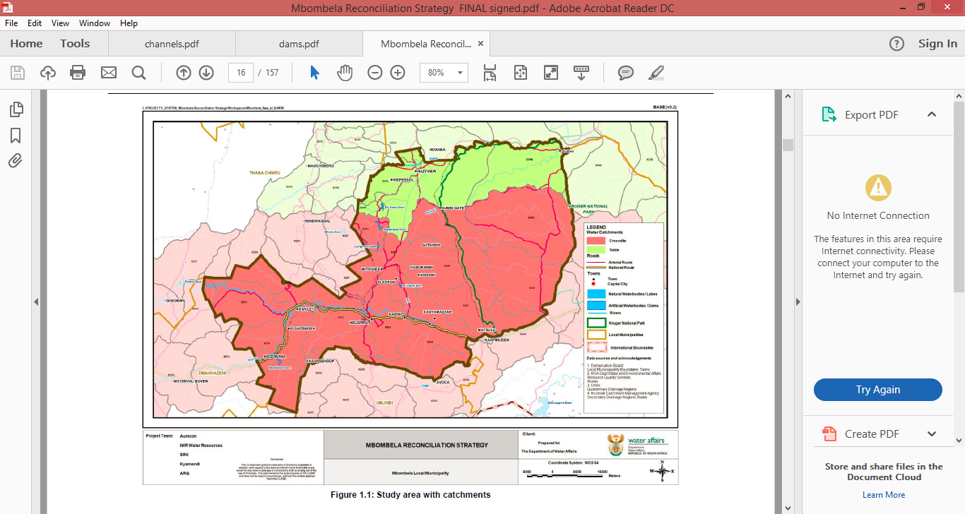
Background to this Assignment
Reconciliation Strategy for the Mbombela Municipal area was developed (2014)
Recommends sequence of management and infrastructural interventions required to maintain acceptable assurances of supply to the users.

Slide 6
Outcomes of previous assignment
Options for reconciling increasing water requirements with the current supply in the Crocodile and Sabie Catchments included:
Water Conservation and Demand Management (WC/WDM)
Removal of Invasive Alien Plants (IAPs)
Reallocation of water (pending DWS approval)
System Operating Rules for Primkop Dam and other upstream dams (yield optimisation)
Groundwater development
Rain and fog harvesting

Slide 7
Outcomes of previous assignment
Regional Dam: 3 possible schemes were identified in the Crocodile River catchment:
Montrose Dam (eliminated – other options more economical)
Mountain View Dam (to be investigated further – feasibility study)
Strathmore off-channel storage dam (to be investigated further – feasibility study)
Please visit: http://www6.dwa.gov.za/iwrp/projects.aspx for all project related information

Slide 8
Why Continuation of a Strategy? (This Study)
Water balances need to be continuously monitored / investigated and the strategy regularly updated to remain technically relevant.
Ensures that intervention planning can be implemented taking into account any changes that may impact on the projected water balance.
Study Objective: In-depth review, systematically update and improve the water resource reconciliation strategy so that it remains relevant, technically sound, economically viable, socially acceptable and sustainable and thus enabling the implementation of the strategy by the relevant authorities.

Slide 9
Purpose of the Meeting
Overview of study activities since StraSC Meeting 2
Feedback on Strategy interventions

Slide 10
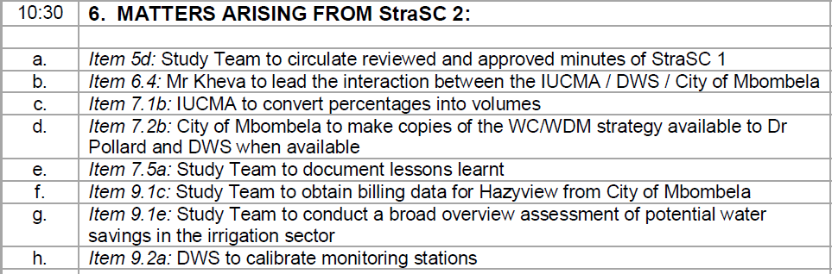
Matters Arising: Action list

Slide 11
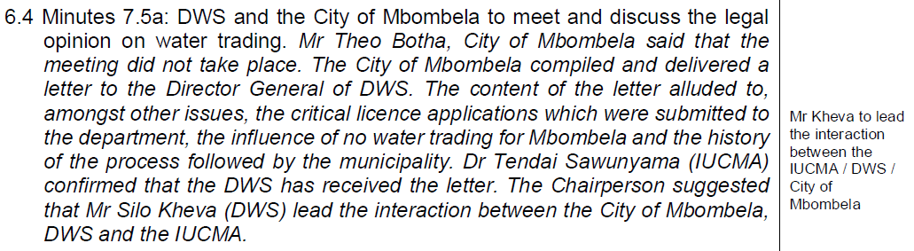
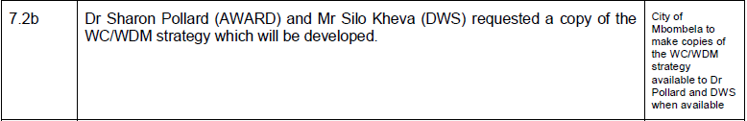
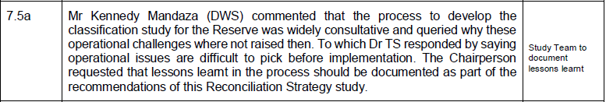

Slide 12
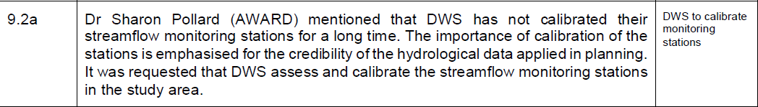

Slide 13
CONTINUATION OF WATER REQUIREMENTS AND AVAILABILITY RECONCILIATION STRATEGY FOR THE MBOMBELA MUNICIPAL AREA (Crocodile Sabie River System Reconciliation Strategy) Strategy Steering Committee Meeting StraSC 3 Item 7: Status of Strategy (2014) Interventions

Slide 14
Intervention (from 2014 Strategy) | Representative Feedback
Addressing Unlawful Irrigation Use (Compliance Monitoring and Enforcement) | IUCMA: A Mbalathi
WC/WDM Urban | City of Mbombela: T Botha Bushbuckridge LM: R Baloyi
WC/WDM in the Irrigation Sector and Relinquishing of Water Savings | Dept Agric: Marius van Rooyen
Water Re-allocation | IUCMA: T Sawunyama
License conversions | DWS HO: Either P Mlilo or K Mandaza
Removal of IAPs | Working for Water: B Mashabane
Groundwater Development | IUCMA: T Sawunyama
Operationalisation of the Reserve | KNP: E Riddell
Pre-Feasibility Study into Dams & thereafter New Dam Constructed | DWS HO: K Bester
System Operating Rules for Sabie River | PSP: C Seago
Operating Rules for Primkop Dam | PSP: C Seago

Slide 15

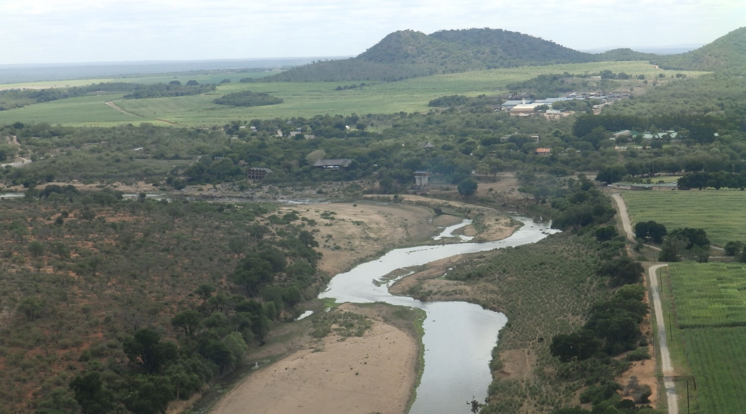

Progress on Implementation of the EWR in Crocodile and Sabie Rivers
Continuation of the Mbombela Reconciliation Strategy, Sept 2019

Slide 16
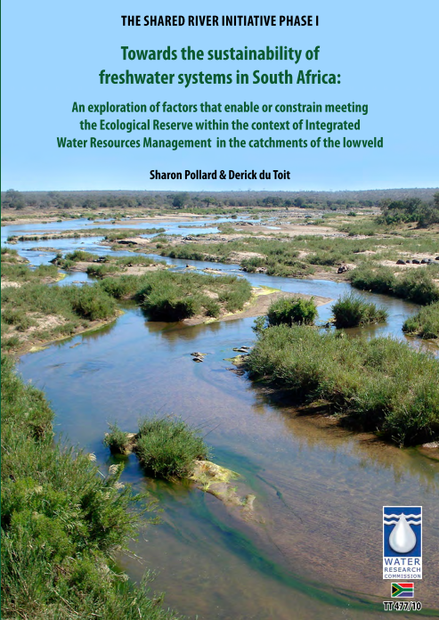
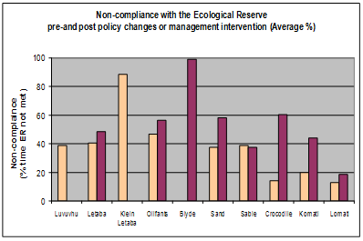

Status-Quo: Ecological Reserve Environmental Water Requirements

Slide 17
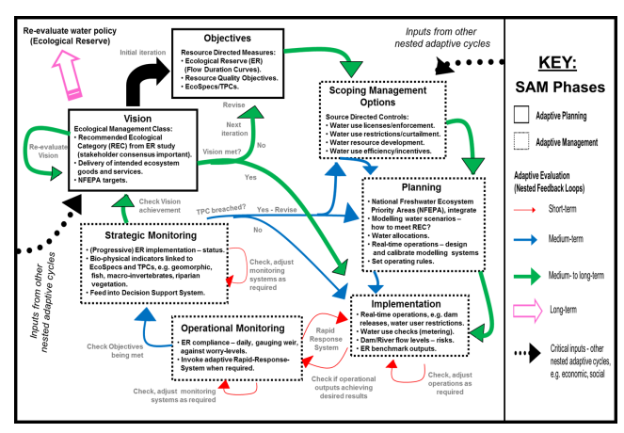
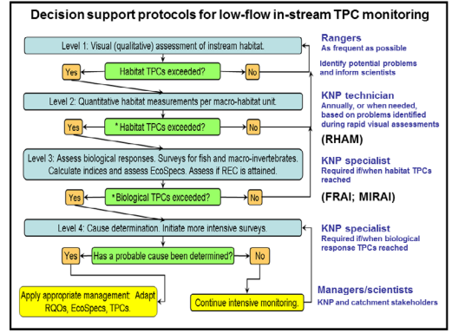
Adaptive Management Operationalization for Rivers
Implementation of Strategic Adaptive Management for freshwater protection under the South African national water policy (McGloughlin et al, 2011, Water Research Commission)

Slide 18
Functional governance systems: Feedback loops Establishment of the CROCOC c. 2009
Users
Mozambique
NDWA
DWA RO
CMIB
ICMA
Kwena Dam bailiff
KNP
Monitor benchmark
(International obligation)
Monitors various benchmarks
Monitors benchmark
(‘Reserve)
Adapted from Pollard and du Toit. 2011.

Slide 19

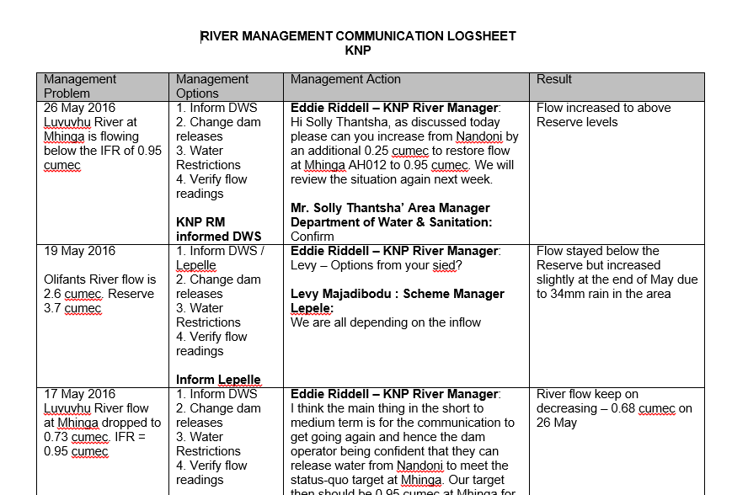
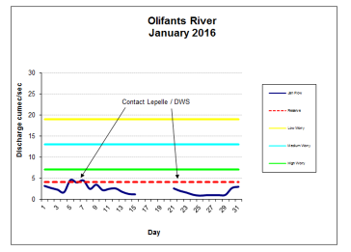
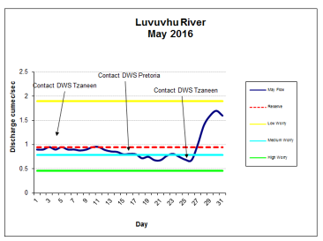
KNP Rivers: Management Actions
Instituted work by McLoughlin et al. 2011.
‘History, rationale, and lessons learned: Thresholds of potential concern in Kruger National Park river adaptive management’,
Koedoe 53(2)

Slide 20
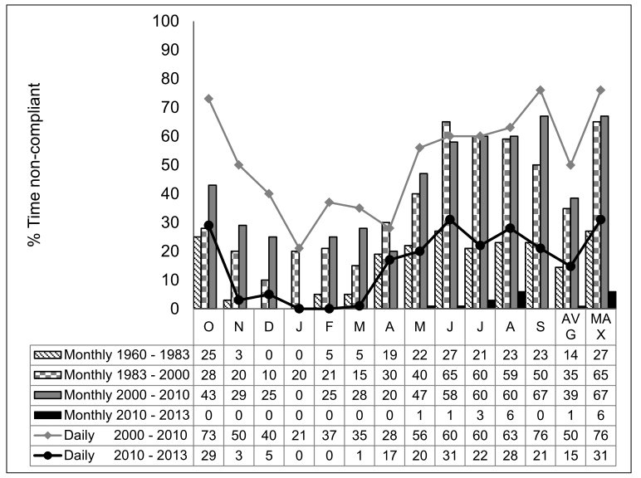
Brian Jackson (2015)
Edward Riddell, Sharon Pollard, Stephen Mallory & Tendai Sawunyama (2014)
Hydrological Sciences Journal

Slide 21
Drought Responses?

Slide 22
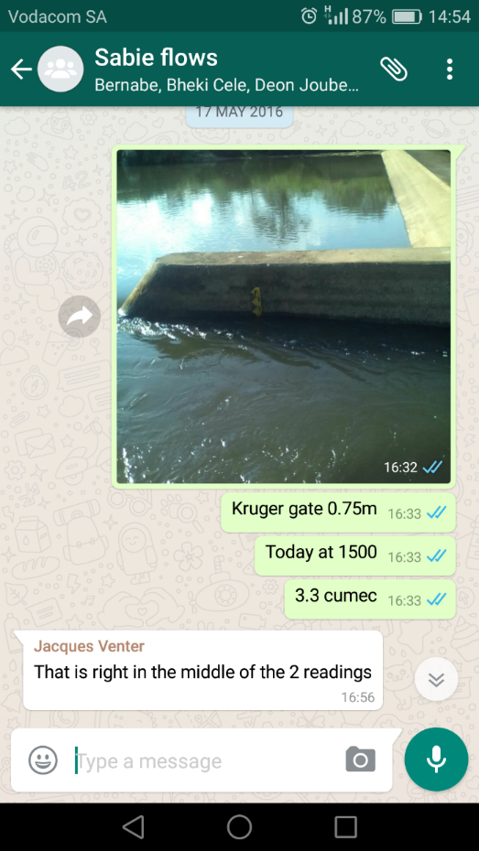
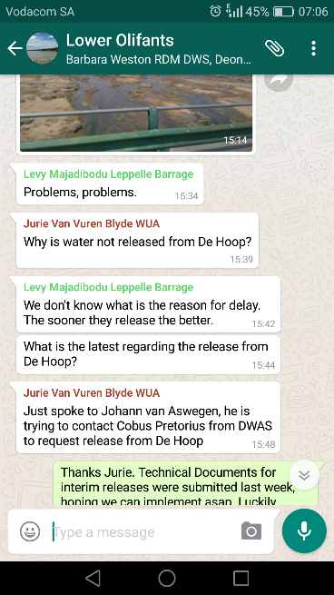
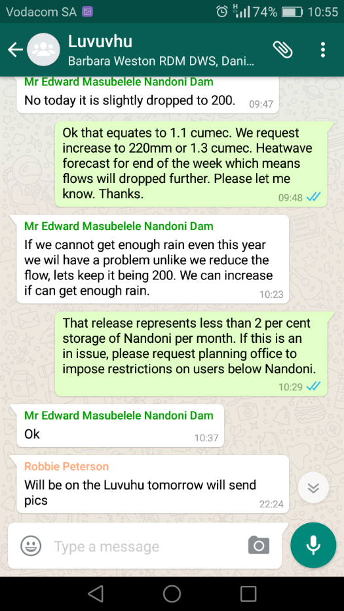
Social Media: Real-Time Communication, Accountability

Slide 23
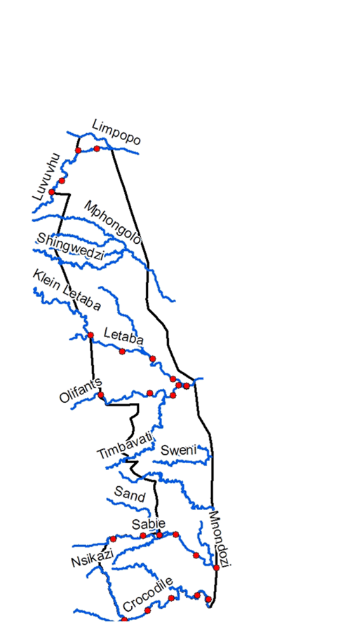
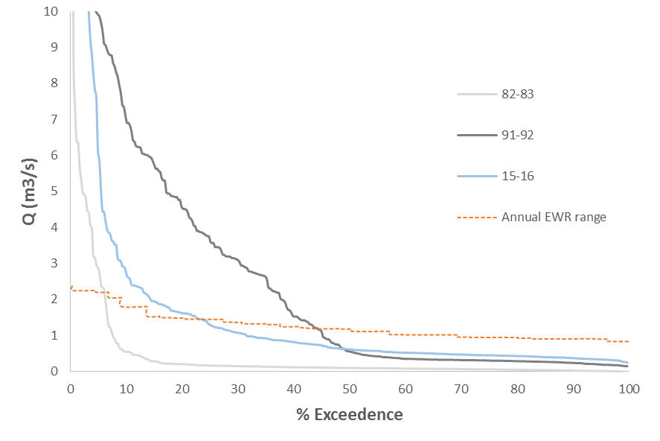
Flows Kruger Western Boundary – Crocodile River @ Tenbosch

Slide 24
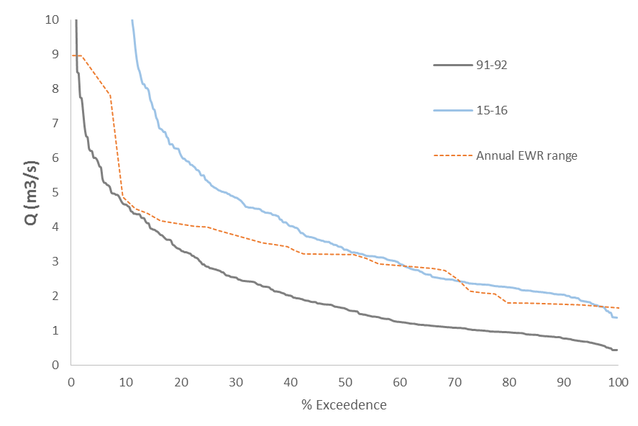
Flows Kruger Western Boundary – Sabie @ Kruger Gate

Slide 25
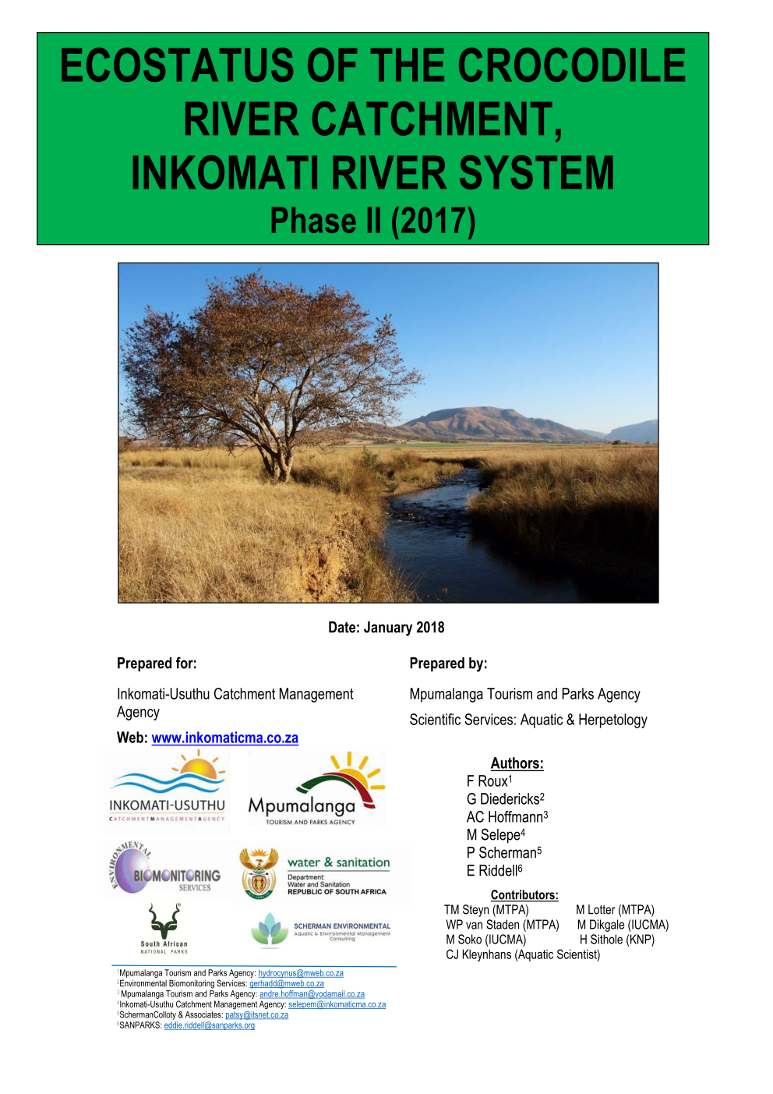
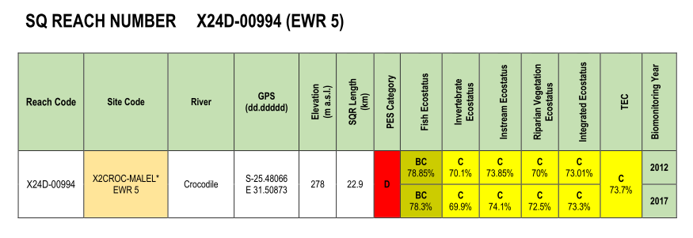
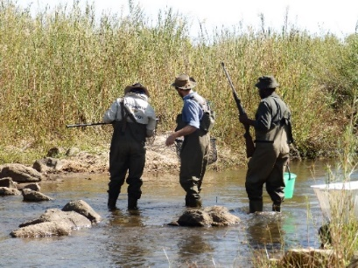
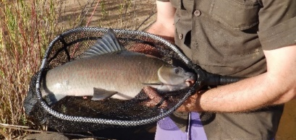
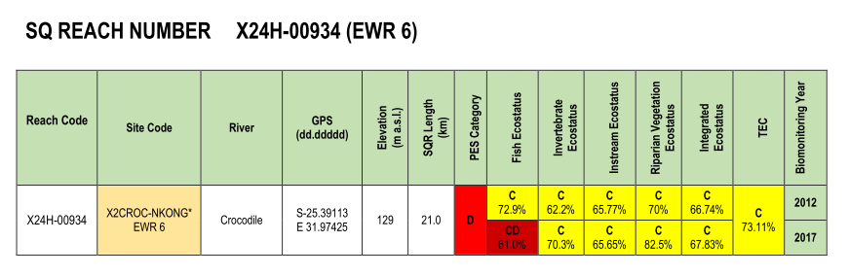
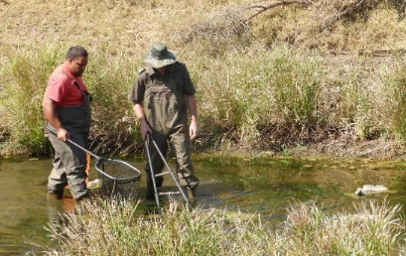

Slide 26

Thank you!

Slide 27
Intervention (from 2014 Strategy) | Representative Feedback
Addressing Unlawful Irrigation Use (Compliance Monitoring and Enforcement) | IUCMA: A Mbalathi
WC/WDM Urban | City of Mbombela: T Botha Bushbuckridge LM: R Baloyi
WC/WDM in the Irrigation Sector and Relinquishing of Water Savings | Dept Agric: Marius van Rooyen
Water Re-allocation | IUCMA: T Sawunyama
License conversions | DWS HO: Either P Mlilo or K Mandaza
Removal of IAPs | Working for Water: B Mashabane
Groundwater Development | IUCMA: T Sawunyama
Operationalisation of the Reserve | KNP: E Riddell
Pre-Feasibility Study into Dams & thereafter New Dam Constructed | DWS HO: K Bester
System Operating Rules for Sabie River | PSP: C Seago
Operating Rules for Primkop Dam | PSP: C Seago

Slide 28
CONTINUATION OF WATER REQUIREMENTS AND AVAILABILITY RECONCILIATION STRATEGY FOR THE MBOMBELA MUNICIPAL AREA (Crocodile Sabie River System Reconciliation Strategy) Strategy Steering Committee Meeting StraSC 3 Item 8: Overview of Study Activities

Slide 29
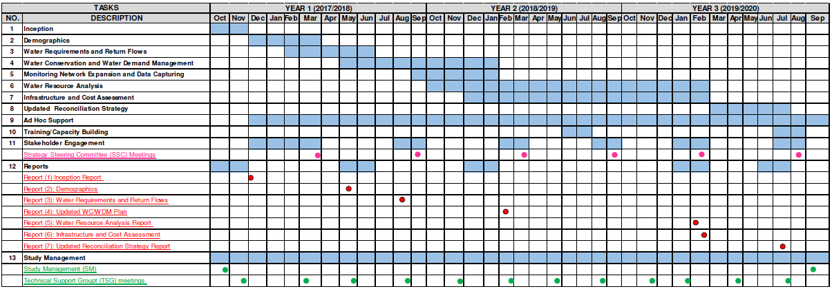
STUDY PROGRAMME

Slide 30
STUDY TASKS
TASK NUMBER | TASK DESCRIPTIONS
1 | Inception and Literature Review
2 | Economic Growth and Demographic Analysis
3 | Water Requirements and Return Flows
4 | Water Conservation and Demand Management
5 | Monitoring Network Expansion and Data Capturing
6 | Water Resources Analysis
7 | Infrastructure and Cost Assessment
8 | Preliminary and Updated Reconciliation Strategy
9 | Ad Hoc Support
10 | Capacity Building and Training
11 | Stakeholder Engagement
12 | Study Reports
13 | Study Management

Slide 31
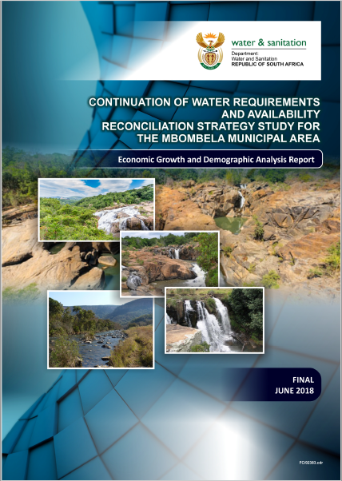
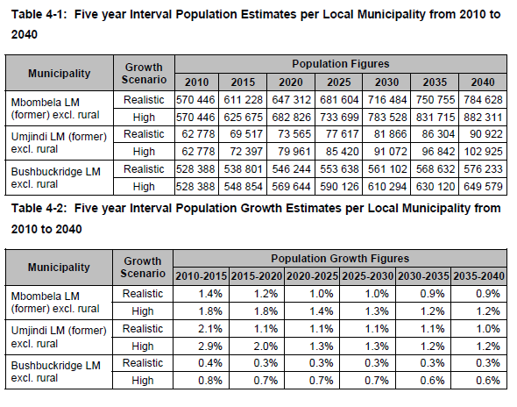

Slide 32
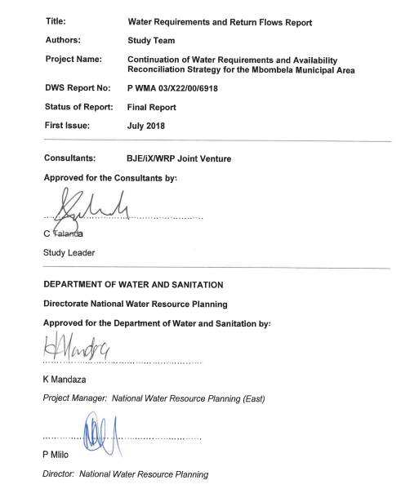
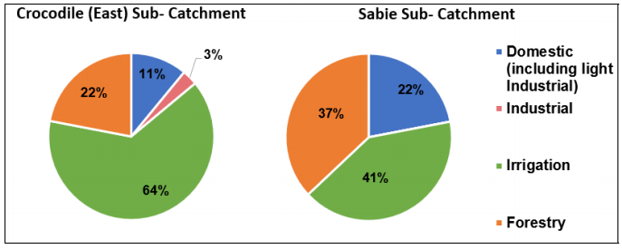

Slide 33
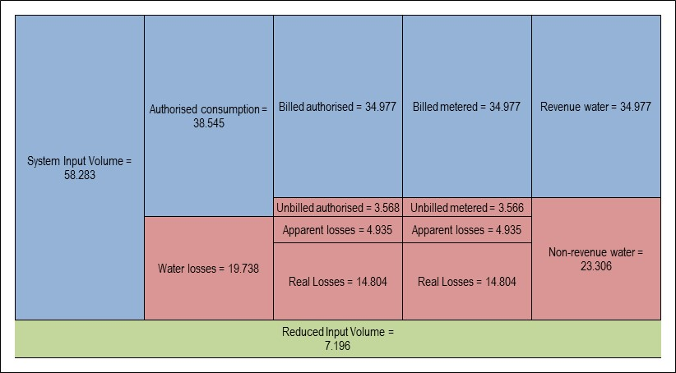
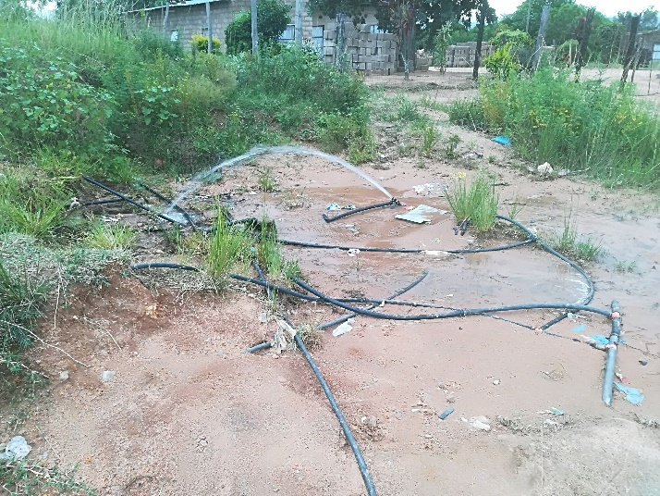
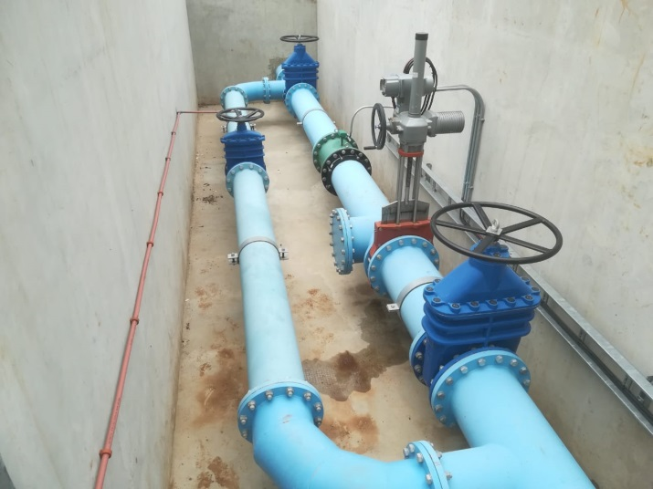

Slide 34
CONTINUATION OF WATER REQUIREMENTS AND AVAILABILITY RECONCILIATION STRATEGY FOR THE MBOMBELA MUNICIPAL AREA (Crocodile Sabie River System Reconciliation Strategy) Strategy Steering Committee Meeting StraSC 3 Item 9: Current Progress

Slide 35
CONTINUATION OF WATER REQUIREMENTS AND AVAILABILITY RECONCILIATION STRATEGY FOR THE MBOMBELA MUNICIPAL AREA (Crocodile Sabie River System Reconciliation Strategy) Strategy Steering Committee Meeting StraSC 3 Item 9.1: Water Resources Assessment

Slide 36
9.1: TASK 7: Water Resources
Hydrology, system yields, water resource model configuration
Previous Water Resources Studies:
DWS: Inkomati Water Availability Assessment (2009)
DWS: IWAAS Maintenance (2012)
DWS: Classification Study (2013)
DWS: Reconciliation Strategy Study (2014)
IUCMA: Operational Support (ongoing)
IUCMA: Hydrology updates: Croc East (draft completed)
Water Resources Summary, Mbombela Recon Strategy (2014)
Water reconciliation strategy update for the schemes in the Sabie and Sand river system Bushbuckridge Local Municipality (2016)

Slide 37
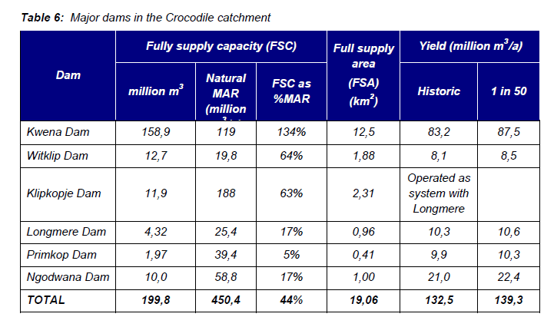
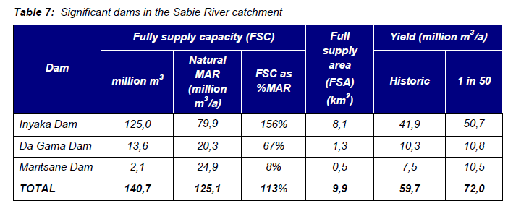
Mbombela Recon (2014) Water Resources Report Yields from IWAAS

Slide 38
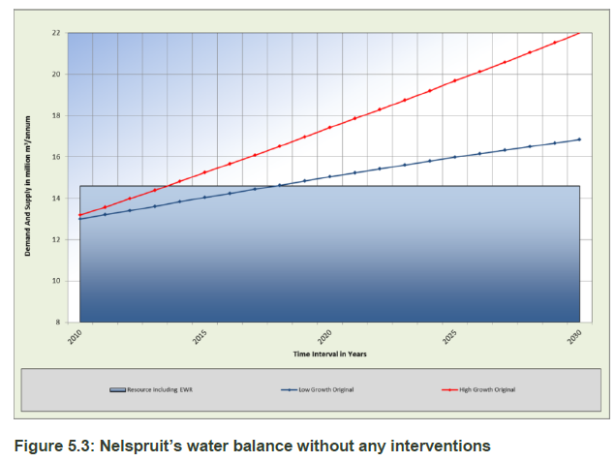
Recon (2014) Water Balance
Resource including EWR: 14.6 million m³/a

Slide 39
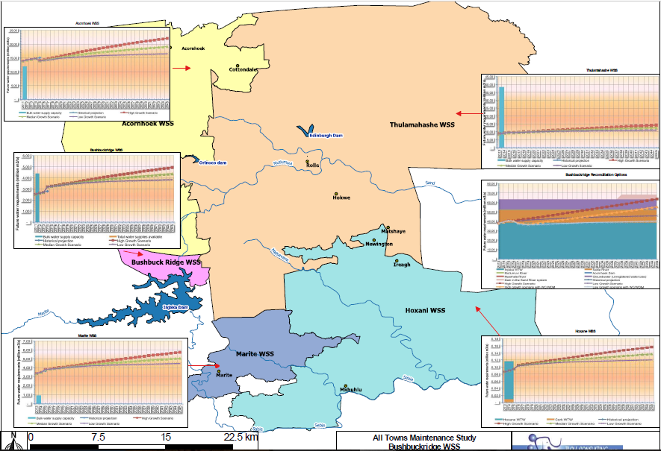
Bushbuckridge Recon (2016)

Slide 40
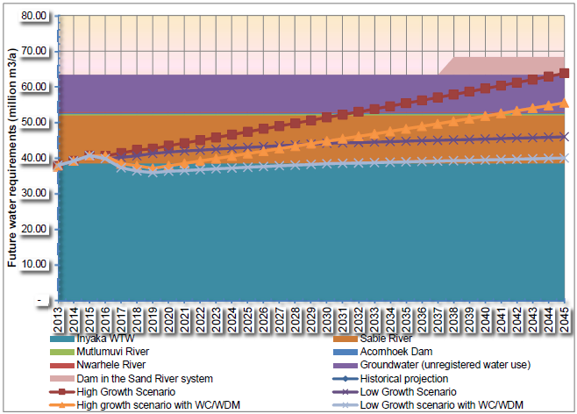
Bushbuckridge Recon (2016)
Inyaka WTW: 36.5 million m³/annum
Sabie River: 14 million m³/annum
Groundwater: 10.5 million m³/annum

Slide 41
Hydrology
IWAAS
Major study, detailed landuse evaluation, external review
WRYM configured, yields produced
IWAAS Maintenance
Small adjustments to hydrology in some catchments due to evaporation error
Current IUCMA update: Crocodile East
TSG 6 decision: Incorporate new hydrology in future Strategy Update once approved, remain with IWAAS Maintenance for this Strategy update and focus on model configuration enhancements

Slide 42
Comparison / Review (Natural MAR million m³/a)
 | 1920-2004 | 1920-2016
Tertiary | IWAAS Maint. | Update (2019)
X21 | 467.3 | 493.8
X22 | 381.9 | 394.7
X23 | 195.4 | 210.5
X24 | 106.6 | 112.0
Total | 1151.1 | 1211.0
Summary: Update results in higher MAR than original IWAAS, despite evidence of drought/low rainfall in recent years. Remaining with IWAAS hydrology is a conservative approach

Slide 43
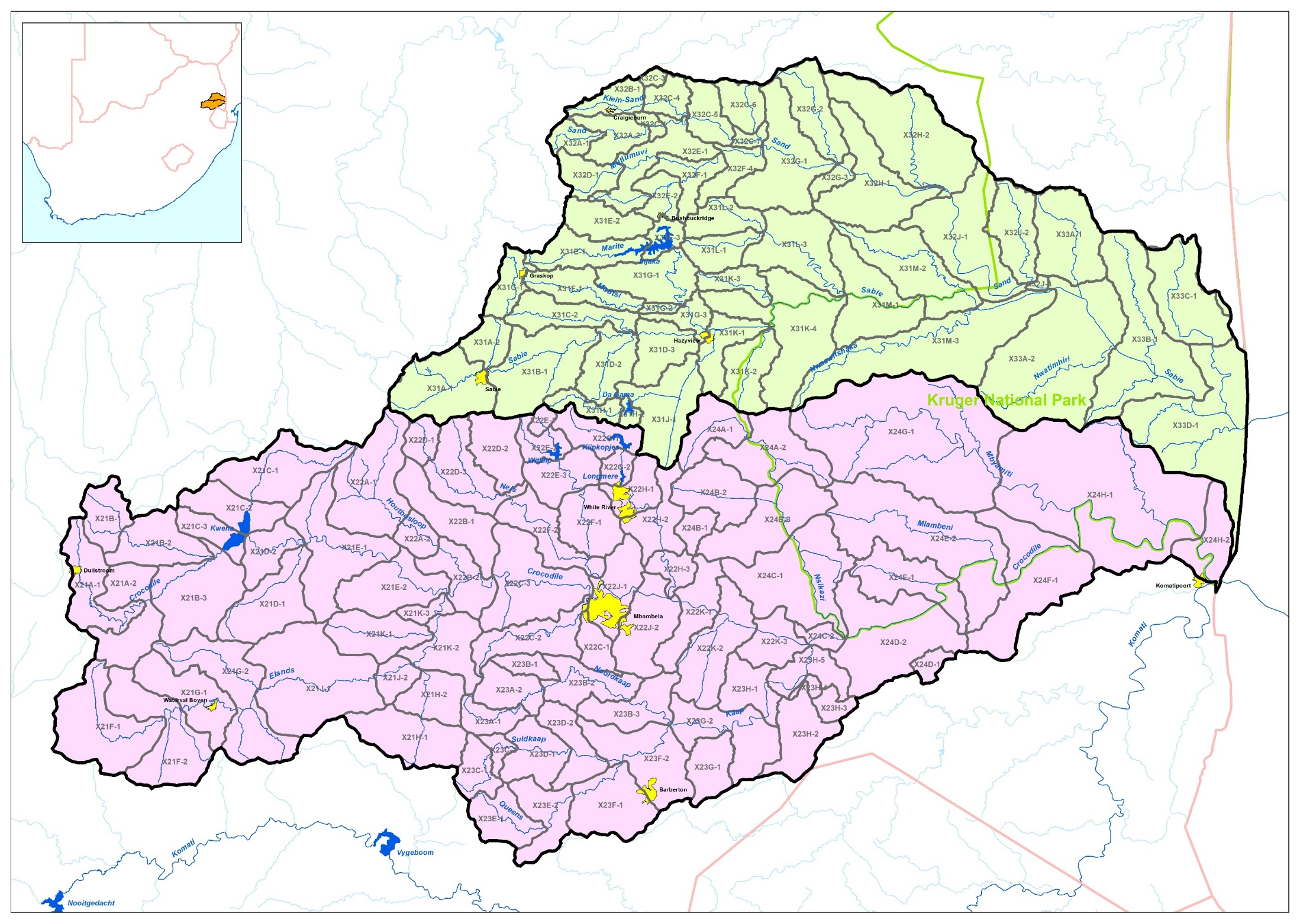
140 Sub-catchments

Slide 44
Model Updates / Enhancements
IWAAS WRYM used as base
2 individual model configurations (1 Sabie/Sand, 1 Crocodile East)
Landuse remains as per IWAAS (Agreed in Water Requirements Task of Study)
Combination into 1 WRPM configuration to assess future growth in water requirements and integrated WRM
Incorporation of Demand Centres
Incorporation of Irrigation
Incorporation of EWRs
Configuration of operating rules

Slide 45
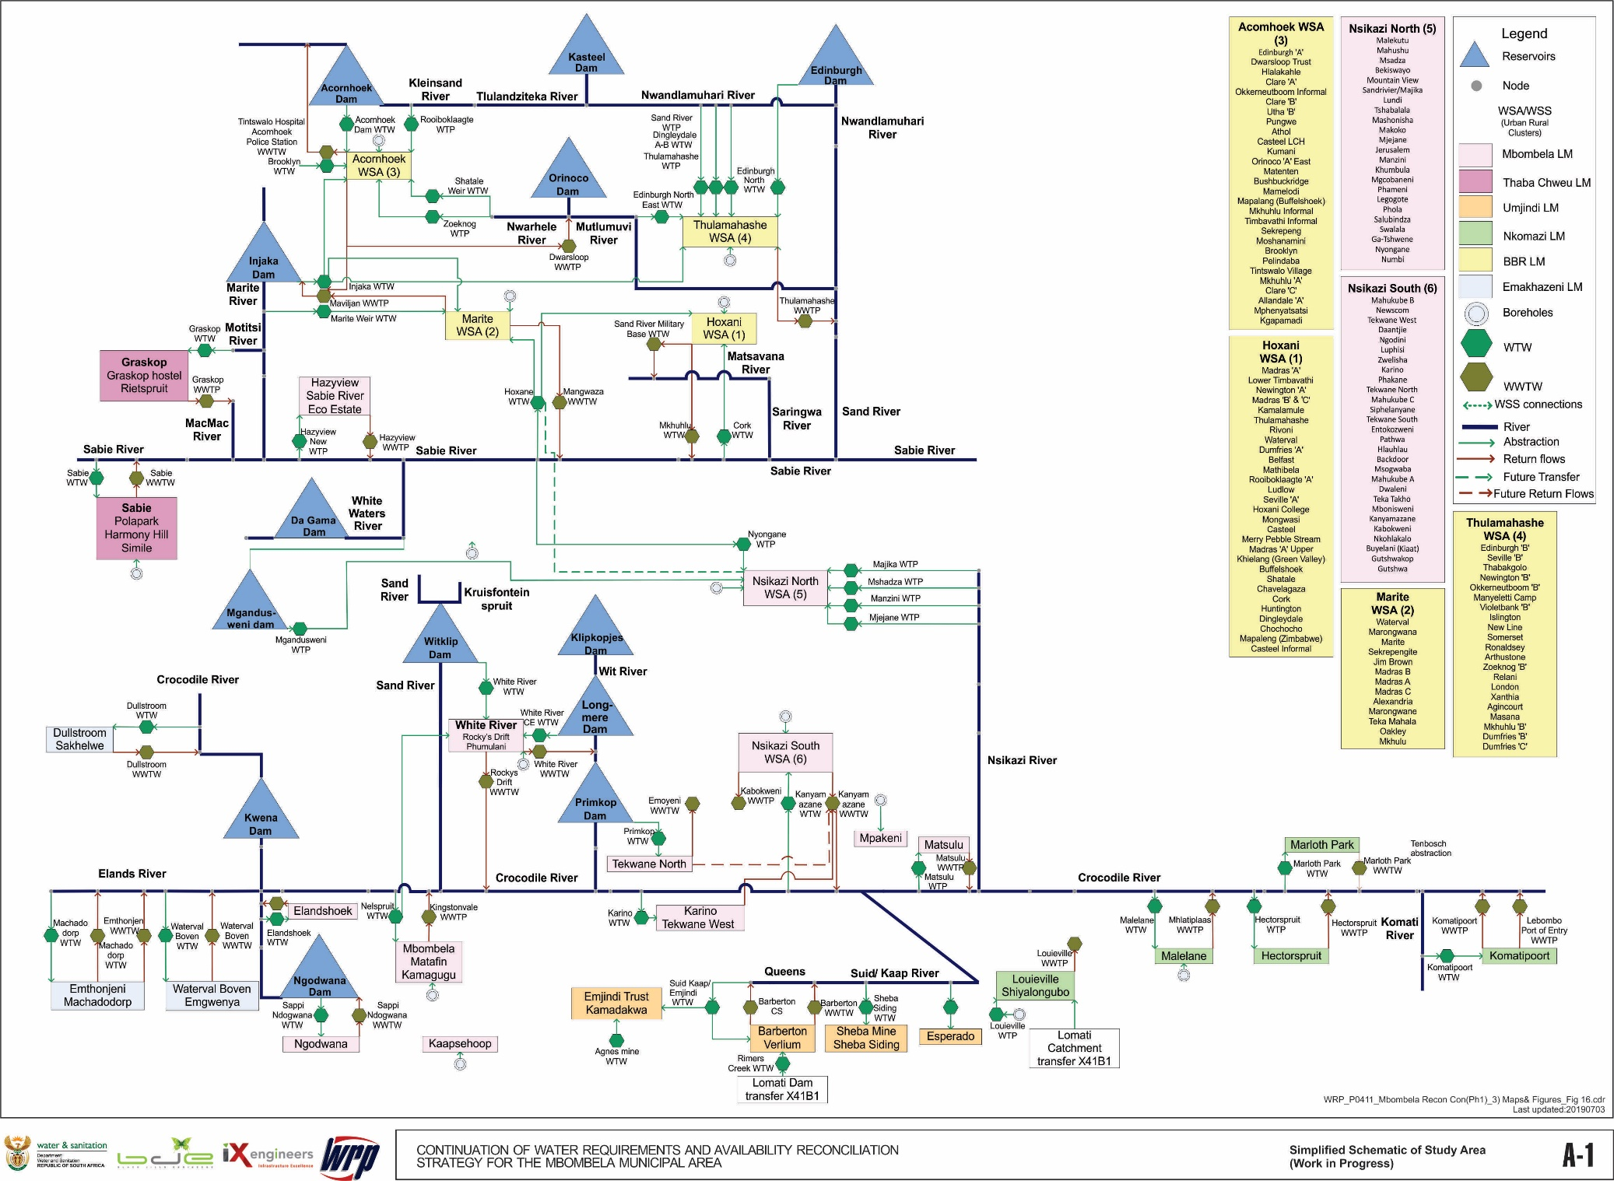
Demand Centres

Slide 46
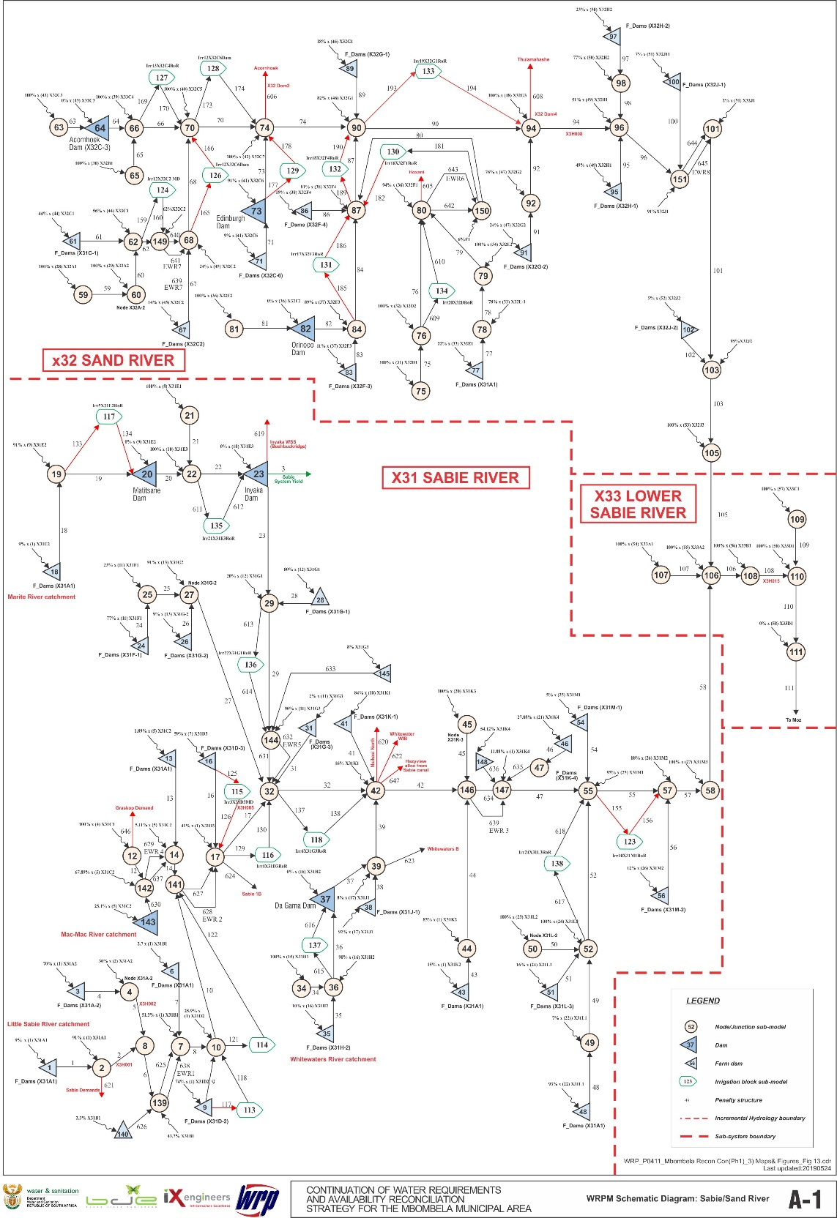
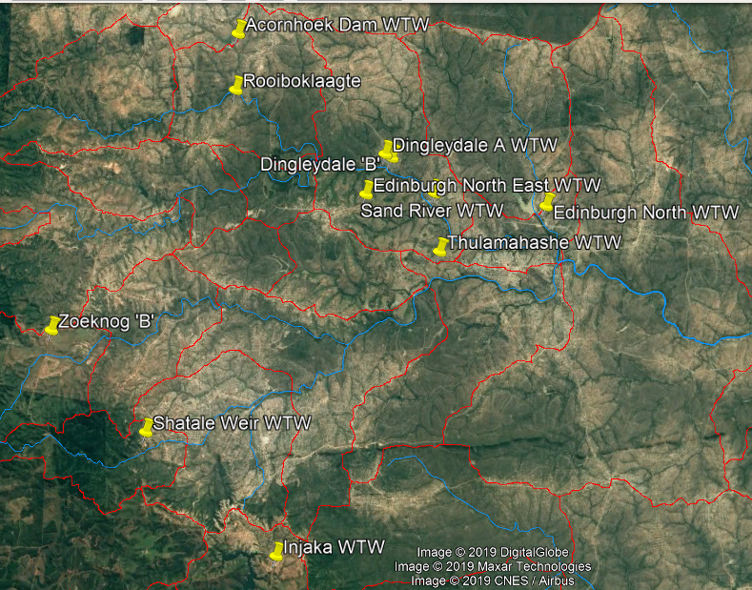
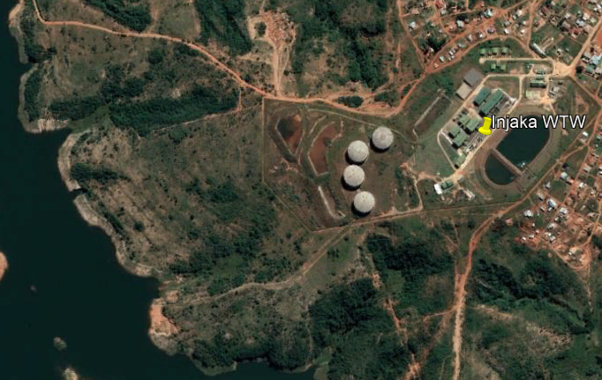
Acornhoek

Slide 47
Irrigation
Irrigation schemes & diffuse irrigators
Based on IWAAS information
Summary (6 schemes simulated at 22 abstraction points):
Board | Demand (million m³/a)
Croc board | 312.9
Elands IB | 7.9
Kaap | 36.4
Sabie Board | 10.9
White river | 30.4
White Waters IB | 15.6
Total | 414.1

Slide 48
EWRs
7 sites on Crocodile, 8 sites on Sabie/Sand
Classification undertaken, 2014
WRYM not used for Classification, therefore EWR structures and locations not included
No specific report relating to water resources analyses available from Classification
Two Gazettes have been published
January 2016: Proposed Classes of Water Resources and Resource Quality Objectives for the Catchments of the Inkomati
November 2017: Proposed Reserve Determination of Water Resources for the Inkomati River Catchment
Incorporated EWR structures into model

Slide 49
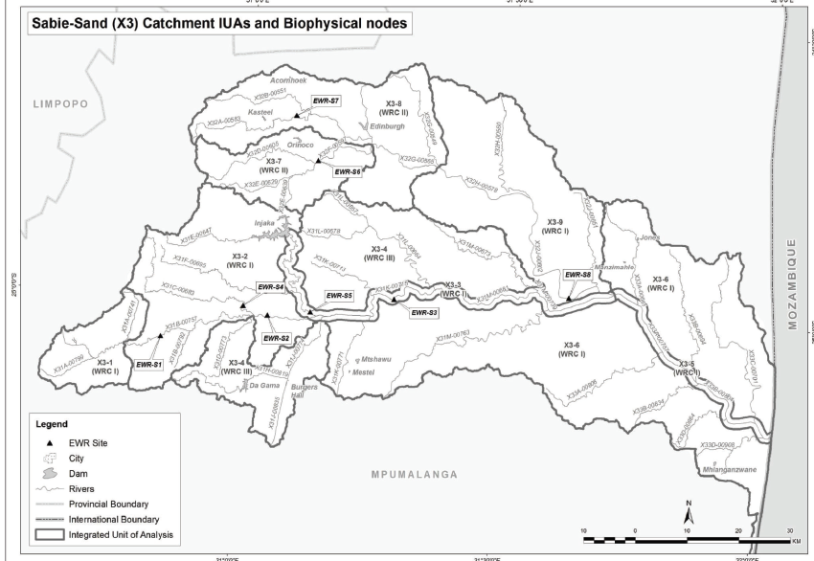
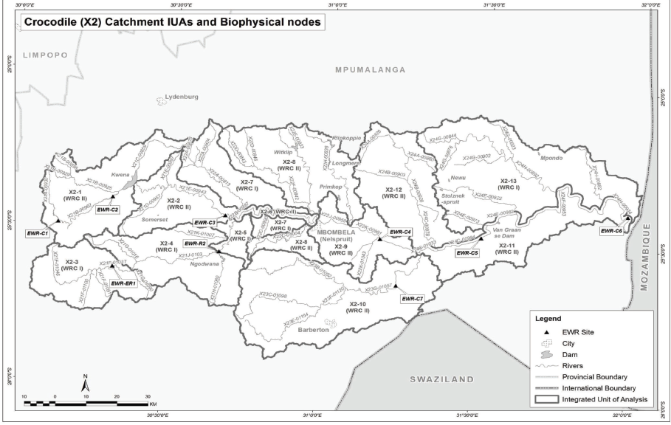

Slide 50
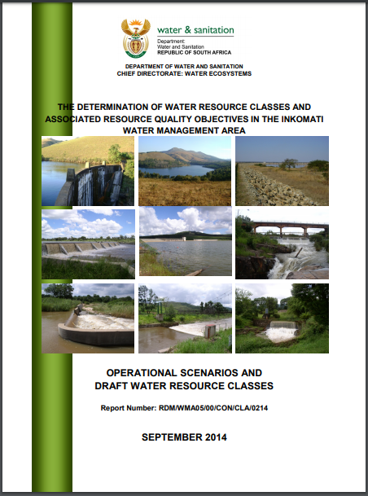
“All three the proposed scenarios (Sc C3, C62 and C82) are where the “PES” releases are the target EWR and allow progressive improvements in both the ecological health as well as the socioeconomic conditions in future.”

Slide 51
Operating Rules (supplied by IUCMA)
Catch-ment | Dam trigger | Dam level % | Restriction % | Supply factor | Sector
Croc | Kwena | 70 | 35 | 0.65 | Irrig
 |  | 55 | 60 | 0.4
 |  | 10 | 100 | 0
 |  | 60 | 10 | 0.9 | Dom
 |  | 40 | 20 | 0.8
 |  | 20 | 30 | 0.7
 |  | 10 | 10 | 0.9 | Ind
Sabie | Inyaka | 65 | 40 | 0.6 | Irrig
 |  | 20 | 60 | 0.4
 |  | 60 | 10 | 0.9 | Dom
 |  | 40 | 20 | 0.8
 |  | 20 | 30 | 0.7

Slide 52

Scenarios & Results: Sabie-Sand
With and without restriction rule
Groundwater contribution (10.5 million m³/a)
Bushbuckridge Transfer Pipeline (25 million m³/a capacity)
Inyaka Starting storage (May 2018): 78%
Inyaka Dam yield (IWAAS) including EWR:

Slide 53
Probability distribution (boxplot)
0 % 5.0 % 25 % 50 % 75 % 95 % 100 %
Percentage of sequence results exceeding given value
Results for generated sequences

Slide 54
Typical Urban criteria
98% assurance of supply
=
2% risk of non-supply
=
1 in 50 year recurrence interval

Slide 55




Bushbuckridge Supply
Inyaka Dam
50
150
2% Risk of non-supply
2018
2040
98% Exceedance probability of storage
No restriction rule in place
Hoxani Supply
Marite Supply
20
5

Slide 56



Bushbuckridge Supply
Including BTP Capacity
Inyaka Dam
2025
Excluding BTP Capacity
Bushbuckridge Supply
Inyaka Dam
2037

Slide 57




Bushbuckridge Supply
Inyaka Dam
150
50
Unused Storage
2018
2040
Dam 60% = 10% restrict
Including restriction rule
Dam 40% = 20% restrict
Dam 20% = 30% restrict
Hoxani Supply
Marite Supply
20
5

Slide 58


2002
2019

Slide 59
Sabie-Sand: Summary
Bushbuckridge Transfer Pipeline capacity restricts users from year 2025
Resource sufficient to meet growing requirements and EWR up till 2037 (excluding restrictions)
Restriction Rule needs to be addressed as it is currently too strict and does not provide sufficient utilisation of resource
Recommend adaptive drought operating rules which dynamically change the reservoir level restriction trigger as water requirements increase over time

Slide 60

Scenarios & Results: Crocodile East
With and without restriction rule
Kwena Dam Starting storage (May 2018): 75%
Kwena Dam yield (IWAAS) including EWR:

Slide 61




Crocodile Irrigation Supply
Kwena Dam
180
300
2018
2040
Dam fails at 75% probability
No restriction rule in place
Mbombela (Nelspruit WTW) Supply
White River Supply
30
12
Supplied better, own resources
2% risk of non supply

Slide 62




Crocodile Irrigation Supply
Kwena Dam
180
300
2018
2040
Dam 70% = 35% restrict
Rule protects dam
Including restriction rule
Dam 55% = 60% restrict
Dam 10% = 100% restrict
Mbombela (Nelspruit WTW) Supply
White River Supply
30
12
2% risk of non supply

Slide 63
Other Studies for Comparison
Inkomati Water Management Area: Internal Strategic Perspective (ISP, 2004):
Yield at 98% assurance of supply (1 in 50 year)
Crocodile system: 264 million m³
Requirements (2003 development level): 413 million m³
Deficit: 149 million m³
Progressive Realisation of the IncoMaputo Agreement (PRIMA, 2011)
Yield at 90% assurance of supply (1 in 10 year)
Crocodile system: 446 million m³
Requirements: 557 million m³
Deficit: 111 million m³

Slide 64
Summary and Way forward
Base results indicate the Crocodile system is in severe deficit
Determine system yield availability and compare with previous studies
Test/recommend operating rules
Include interventions & reassess risk of supply failure and quantify restrictions
Produce annual water balance plots

Slide 65
CONTINUATION OF WATER REQUIREMENTS AND AVAILABILITY RECONCILIATION STRATEGY FOR THE MBOMBELA MUNICIPAL AREA (Crocodile Sabie River System Reconciliation Strategy) Strategy Steering Committee Meeting StraSC 3 Item 9.2: Infrastructure and Cost Assessment

Slide 66
Agenda Item 9.2: task 7: INFRASTRUCTURE AND COST ASSESSMENT Evaluation of the infrastructure intervention options that were identified during the previous reconciliation strategy and the related cost and financial implications.

Slide 67
Infrastructure: Groundwater Sabie catchment: - Groundwater availability generally low. Groundwater can however be found where dykes and shear zones occur. - Further studies will be required to develop groundwater. Crocodile catchment: - Boreholes are usually drilled as the need arises on request of a local community. - Groundwater availability generally low. Groundwater can however be found where dykes and shear zones occur. Feedback with respect to groundwater was provided earlier on in the agenda.

Slide 68
Infrastructure: Dams (Sabie and Sand River catchment):
Two dams were identified that can augment the water resources in the catchment:
Dingleydale Dam.
Located at the confluence of the Nwarhele and Mtlumuvi river
New Forest Dam
Located at the confluence of the Klein Sand and Sand rivers
These dam sites can be considered should the need arise for an augmentation of the water resources in the catchment.

Slide 69
Infrastructure: Dams (Crocodile River catchment):
A total 5 dams were identified that can augment the water resources in the catchment:
Raising the Primkop dam (White River).
Boschjeskop Dam (Nels River).
Montrose Dam (Crocodile River).
Mountain View Dam (Kaap River).
Strathmore Dam (Off-channel).

Slide 70

Location of proposed dams
Dingleydale Dam
Sabie River Catchment
New Forest Dam
Crocodile River
Catchment
Boschjeskop Dam
Strathmore Dam
Montrose Dam
Mountain View Dam

Slide 71
Infrastructure: Proposed Dams (Crocodile River catchment):
Raising the Primkop Dam
Capacity = 15 Mm³
Yield = 10 Mm³/a
Height = 31.4 m
Low water cost (URV)
Boschjeskop Dam
Capacity = 100 Mm³
Yield = 19.5 Mm³/a
Height = 45 m
Higher water cost (URV)
Montrose Dam
Capacity = 12.2 Mm³
Yield = 60 Mm³/a
Height = 30 m
High water cost (URV), High environmental impact

Slide 72
Infrastructure: Proposed Dams (Crocodile River catchment):
Mountain View Dam
Capacity = 229 Mm³
Yield = 34 Mm³/a
Height = 90 m
Low water cost (URV), low environmental impact
Strathmore Dam
Capacity = 59 Mm³
Yield = 76 Mm³/a
Height = 32 m
Low water cost (URV), located next to a Magnesium mine

Slide 73

Infrastructure: Matsulu Abstraction
At times of low flows in the Crocodile River, the Matsulu Abstraction Works runs short of water due to the diversion of flow into the Van Graan Canal upstream of the abstraction works.
A permanent solution for the problem needs to be identified.

Slide 74
Infrastructure: Matsulu Abstraction
The following possible solutions had been identified:
Revising the permit for the Van Graan canal to make allowance for the domestic water requirements of Matsulu. Current permit allows for 7.8 m³/s to be diverted into the canal.
Moving the Matsulu abstraction pumps to a point downstream of the canal discharge point.
Moving the Matsulu abstraction pumps to a point upstream of the canal entry point (The Kaapmuiden Weir)

Slide 75
Questions?

Slide 76
IMPLEMENTATION AND MAINTENANCE OF THE WATER RECONCILIATION STRATEGY FOR RICHARDS BAY AND SURROUNDING TOWNS Technical Support Group Meeting (TSG) 6 Item 10: Discussion and Comments

